Slide 1
Microsoft Azure: Azure Cosmos DB

Slide 2
Microsoft Azure: Azure Cosmos DB
Abdul Rasheed Feroz Khan
Microsoft MVP – Azure
@TechFero

Slide 3
Session objective
Overview of Azure Cosmos DB
Global data distribution
Consistency, availability, & performance Tradeoffs
High availability
Regional presence with Azure Cosmos DB.
Overview of MongoDB API

Slide 4
Overview of Azure Cosmos DB

Slide 5


Azure Cosmos DB
Globally distributed database service
Notes:
While the Cosmos DB instance is getting created, talk about Cosmos DB. This is the usual pitch, it’s a fundamental service of Azure, much of Azure runs on Cosmos DB already. Available in every region. Globally replicated.

Slide 6
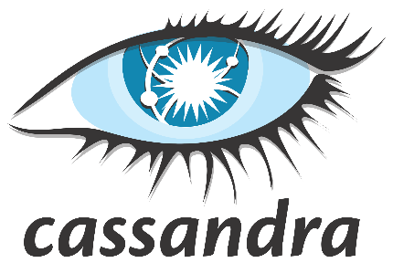



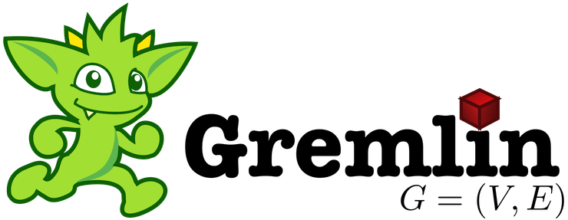

SQL
mongoDB
Azure Cosmos DB
… more coming soon
Key-Value
Column-family
Documents
Graph
Global distribution
Elastic scale out
Guaranteed low latency
Five consistency models
Comprehensive SLAs
A globally-distributed, multi-model database service
Notes:
It is a database born in cloud – from the inception - fundamental design goals was Automatic Global distribution – Limitless scale – Low Latency – High throughput – and Well defined consistency model - SLA
So we Built the platform with these Core Capability.
As a developer you also want the flexibility. With Azure Cosmos DB, you don’t have to model the data in JUST one way. You can model the data the way you want.
Key-Value, Column, Documents or Graph.
That’s why say Cosmos DB is a multi-model database.
What about how you access data. What about frameworks, API and tools that you are familiar with. We do not want you yo learn a new API. We make every API and language a first-c;ass citizen of Azure Cosmos DB. If you are familiar with DocumentDB SQL or DocumentDB JS, we continue to support and innovate on that front. If you are a MongoDB developer, we have support for MongoDB wire protocol. Azure Cosmos DB can be your globally distributed, secure, fully managed Mongo Instance. Today, we announced preview of Azure Tables API and Gremlin for graph capabilities. We have more in the works and our roadmap is to extend this over the coming months to include Hbase, Cassandra and other OSS API.

Slide 7
Resource Model
Account
Database
Database
Database
Database
Database
Container
Database
Database
Item
Notes:
A tenant of the Cosmos DB service starts by provisioning a database account. A database account manages one or more databases. A Cosmos DB database manages users, permissions and containers. A Cosmos DB resource container is a schema-agnostic container of arbitrary user-generated JSON items and JavaScript based stored procedures, triggers and user-defined-functions (UDFs). Entities under the tenant’s database account – databases, users, permissions, containers etc. are referred to as resources.
Each resource is uniquely identified by a stable and logical URI and represented as a JSON document. The overall resource model of an application using Cosmos DB is a hierarchical overlay of the resources rooted under the database account, and can be navigated using hyperlinks. Except for the item resource, which is used to represent arbitrary user defined JSON content, all other resources have a system-defined schema.
Container and item resources are further projected as reified resource types for a specific type of API interface. For example, while using document-oriented APIs, container and item resources are projected as collection (container) and document (item) resources, respectively; likewise, for graph-oriented API access, the underlying container and item resources are projected as graph (container), node (item) and edge (item) resources respectively; while accessing using a key-value API table (container) and item/row (item) are projected.

Slide 8
Account URI and Credentials
Account
********.azure.com
Database
Database
Database
IGeAvVUp …
Database
Database
Container
Database
Database
Item
Notes:
Here we are going to discuss about the authentication of user and providing access to the database. There are two master keys such as primary and secondary key. We can provide the continuous access for the database using these keys.
In addition to the primary and secondary keys there are two read-only keys which allows only to read the operations on the account. These keys can be regenerated using Azure portal.

Slide 9
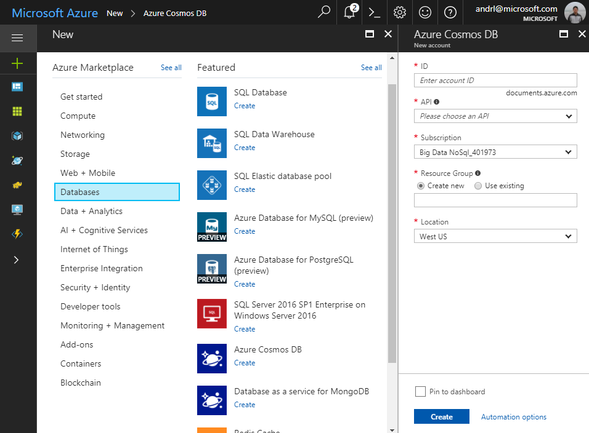
Creating Account
Account
Database
Database
Database
Database
Database
Container
Database
Database
Item
Notes:
Here we are going to discuss about creating Azure Cosmos DB account. Azure Cosmos DB is a globally distributed service. By using Azure Cosmos DB we able to create and query key values and databases. This benefits from the globally distributed, horizontal scale capabilities at the core of Azure Cosmos DB account.

Slide 10
Creating Account
Account
Database
Database
Database
Database
Database
Container
Database
Database
Item
Notes:
Here we are going to discuss about creating Azure Cosmos DB account. Azure Cosmos DB is a globally distributed service. By using Azure Cosmos DB we able to create and query key values and databases. This benefits from the globally distributed, horizontal scale capabilities at the core of Azure Cosmos DB account.

Slide 11
Database Representations
Account
Database has 1 or more containers
Database
Database
Database
Database
Database
Container
Database
Database
Item
Notes:
The schema of the database represents the configurations of the database. It can represent both the visual and set of formulas which is known as integrity constrains which is going to govern the database.
The database is the place where all objects that form a tabular model reside. Contained by the database, the developer finds objects like connections, tables, roles and many more.

Slide 12
Database Representations
Account
Database has 1 or more containers
Database
Database
Database
Database
Database
Container
Database
Database
Item
Notes:
The schema of the database represents the configurations of the database. It can represent both the visual and set of formulas which is known as integrity constrains which is going to govern the database.
The database is the place where all objects that form a tabular model reside. Contained by the database, the developer finds objects like connections, tables, roles and many more.

Slide 13
Container Representations
Account
Container – can be a collection, graph or table
Database
Database
Database
Database
=
Database
Container
Collection
Graph
Table
Database
Database
Item
Notes:
An Azure Cosmos container is the unit of scalability both for provisioned throughput and storage. A container is horizontally partitioned and then replicated across multiple regions. The items that you add to the container and the throughput that you provision on it are automatically distributed across a set of logical partitions based on the partition key.
The throughput provisioned on a container is exclusively reserved for that container and it is backed by the SLAs. These containers share the provisioned throughput with the other containers in the same database (excluding containers that have been configured with dedicated provisioned throughput).

Slide 14
Creating Collections – SQL API
Account
Items – can be document, vertices/edges, or row
Database
Database
Database
Database
Database
Container
Collection
Graph
Table
Database
Database
Item
Document Vertices/Edges Row
Notes:
Here we are going to discuss about the different ways to create an Azure Cosmos container (collection, table, or graph). You can use Azure portal, Azure CLI, or supported SDKs for this. This article demonstrates how to create a container, specify the partition key, and provision throughput.
Id - The user generated unique name for the collection. No two collections can have the same IDs. It is a string that must not be more than 255 characters.
indexingPolicy - This value is used to configure indexing policy. By default, the indexing is automatic for all document paths within the collection.
partitionKey - This value is used to configure the partition key to be used for partitioning data into multiple partitions. To use large partition key, specify the version as 2 within the partitionKey property. If the x-ms-offer-throughput is over 10,000, then the collection must include a partitionKey definition. If the x-ms-offer-throughput is equal to or under 10,000, then the collection must not include a partitionKey definition.

Slide 15
Container-Level Resources
Account
Associate stored procedures, triggers, UDF with container
Database
Database
Database
Database
Database
Container
Database
Database
Sproc
Trigger
UDF
Conflict
Item
Notes:
An Azure Cosmos database is a unit of management for a set of containers. A database consists of a set of schema-agnostic containers. An Azure Cosmos container is the unit of scalability for both throughput and storage. A container is horizontally partitioned across a set of machines within an Azure region and is distributed across all Azure regions associated with your Azure Cosmos account.
An Azure Cosmos container is the unit of scalability both for provisioned throughput and storage. A container is horizontally partitioned and then replicated across multiple regions. The items that you add to the container and the throughput that you provision on it are automatically distributed across a set of logical partitions based on the partition key.
Azure Cosmos DB provides language-integrated, transactional execution of JavaScript that lets you write stored procedures, triggers, and user-defined functions (UDFs). When using the SQL API in Azure Cosmos DB, you can define the stored procedures, triggers, and UDFs in JavaScript language. You can write your logic in JavaScript and execute it inside the database engine.

Slide 16
System design (logical)
Tenants
Follower
Follower
Leader
Forwarder
Tables
Collections
Graphs
Replica set
To a remote resource partition(s)
Container
Resource Partition
A consistent, highly available, and resource governed coordination primitive
Consists of a replica set with each replica hosting an instance of database engine
Uniquely belongs to a tenant
Owns a set of keys
Container
Container
Containers
…
Resource Partitions
Notes:
Azure Cosmos DB uses partitioning to scale individual containers in a database to meet the performance needs of your application. In partitioning, the items in a container are divided into distinct subsets called logical partitions. Logical partitions are formed based on the value of a partition key that is associated with each item in a container. All items in a logical partition have the same partition key value.
For example, a container holds items. Each item has a unique value for the UserID property. If UserID serves as the partition key for the items in the container and there are 1,000 unique UserID values, 1,000 logical partitions are created for the container.
In addition to a partition key that determines the item’s logical partition, each item in a container has an item ID (unique within a logical partition). Combining the partition key and the item ID creates the item's index, which uniquely identifies the item.

Slide 17
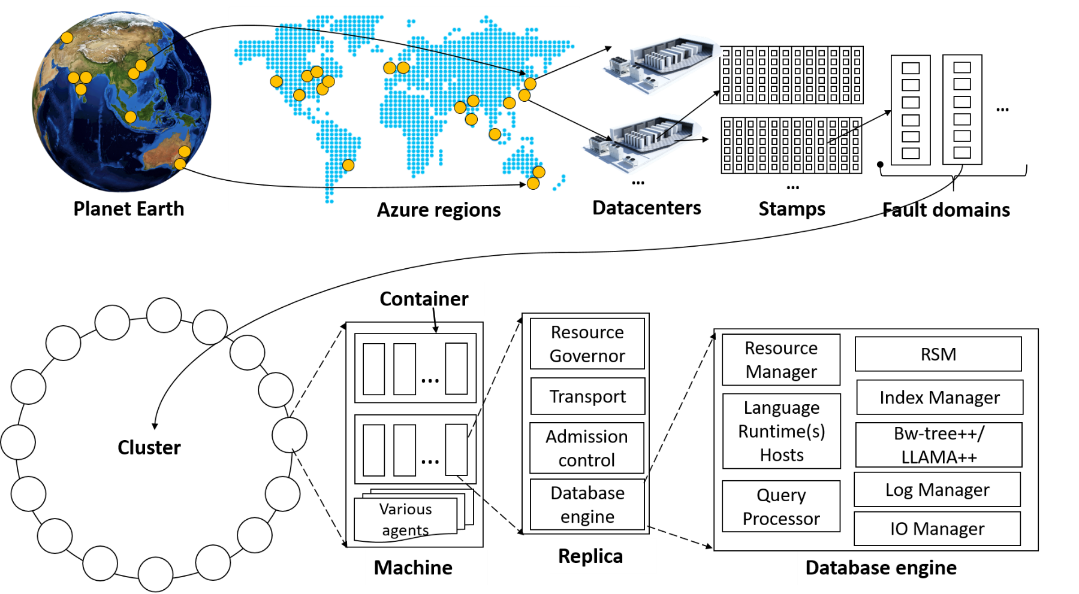
System topology (behind the scenes)
Notes:
The Cosmos DB service is deployed worldwide across all Azure regions including the sovereign and government clouds. We deploy and manage the Cosmos DB service on stamps of machines, each with dedicated local SSDs. The Cosmos DB service is layered on top of Azure Service Fabric, which is a foundational distributed systems infrastructure of Azure. Cosmos DB uses Service Fabric for naming, routing, cluster and container management, coordination of rolling upgrades, failure detection, leader election (within a resource partition) and load balancing capabilities. Cosmos DB is deployed across one or more Service Fabric clusters, each potentially running multiple generations of hardware and of varying number of machines (currently, between 60-800 machines).
Machines within a cluster typically are spread across 10-20 fault domains. The resource partitions is a logical concept. Physically, a resource partition is implemented in terms of a group of replicas, called replica-sets. Each machine hosts replicas corresponding to various resource partitions within a fixed set of processes. Replicas corresponding to the resource partitions are placed and load balanced across these machines. Each replica hosts an instance of Cosmos DB’s schema-agnostic database engine, which manages the resources as well as the associated indexes. The Cosmos DB database engine, in-turn, consists of components including implementation of several coordination primitives, the JavaScript language runtime, the query processor, the storage and indexing subsystems responsible for transactional storage and indexing of data, respectively. To provide durability and high availability, the database engine persists its index on SSDs and replicates it among the database engine instances within the replica-set(s) respectively. While the index is always persisted on local SSDs, the log is persisted either locally, on another machine within the cluster, or remotely across cluster or a datacenter within a region. The proximity of the index and log is configurable based on the price and latency SLA. The ability to dynamically configure the proximity between the database engine (compute) and log (storage) at the granularity of replicas of a resource partition is crucial for allowing tenants to dynamically select various service tiers.

Slide 18
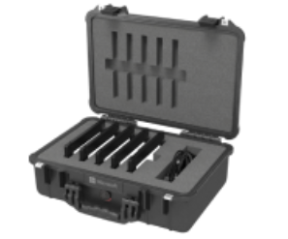
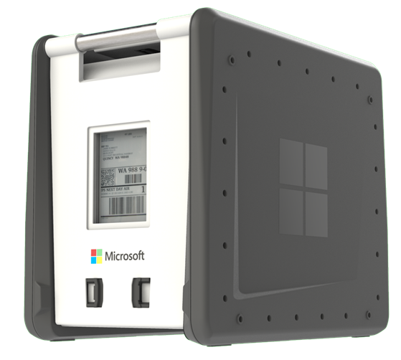
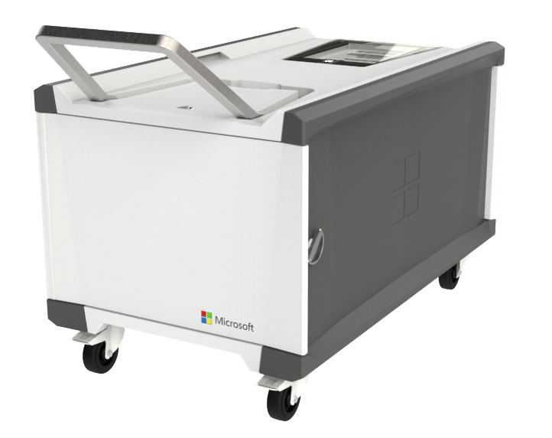
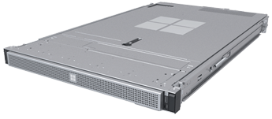

Azure Data Box
General Availability
Data Box Disk
(40 TB)
Data Box
(100 TB)
Data Box Heavy
(1 PB)
Data Box Edge
Data Box Gateway
Provides additional data migration
options
Migrate large amounts of data quickly and securely
Create a link between your premises and Azure storage
Notes:
We also have some possibilities to migrate offline with our Data box. Order one, have it delivered, add your data to it, and ship it back to the data center where our own engineers will migrate the data to your subscription. This is a great solution, for example if you don’t trust the internet. The data on the data box is encrypted, so it’s very safe. Another good use for this solution is if you have very large datasets to migrate, and the internet is slow.

Slide 19
Demo
Walkthrough on Azure Cosmos B

Slide 20

Please evaluate this session Your feedback is important to us!
Please evaluate this session through the website.
Go to the website: https://hackbox.in

